Slide 1

ONLINE RETAIL STORE

Slide 2

OBJECTIVE
The objective is to collaboratively steer our online retail company towards long term growth through innovative leadership and a data- driven, customer-centric digital marketing strategy, thereby increasing revenue, market share and stakeholder value for the company.

Slide 3
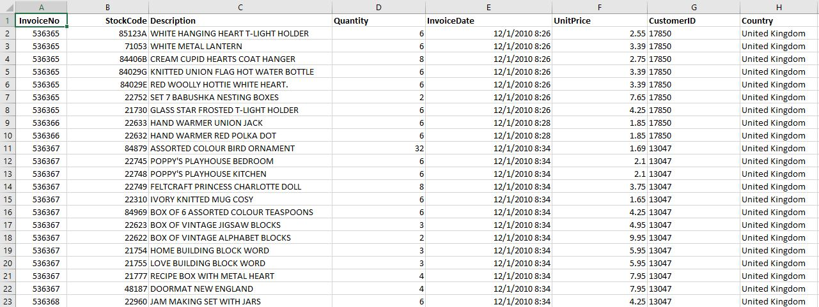
SNAPSHOT OF THE DATA

Slide 4
DATA DICTIONARY
Total 8 columns
Some important columns are-
Invoice No
Stock Code
Description
Quantity
Invoice Date
Unit Price
Customer ID
Country

Slide 5

ANALYSIS OF DATA

Slide 6
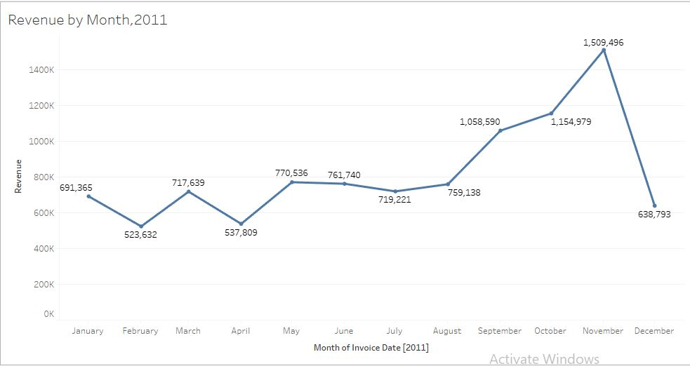
REVENUE BY MONTH
The first 8 months had a stable monthly revenue however there is a significant increase in revenue from August
The highest revenue is in the month of November

Slide 7
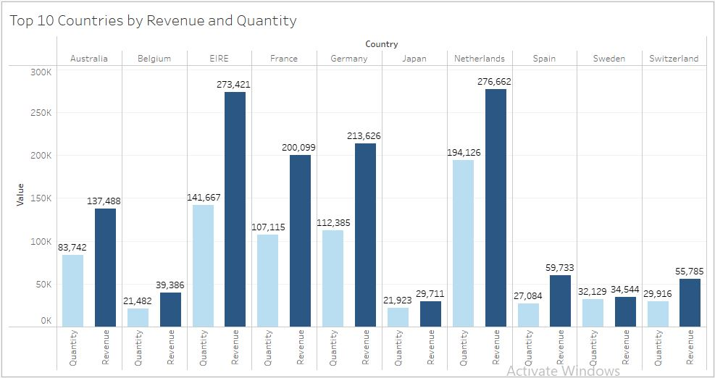
TOP 10 COUNTRIES
This chart represents the top 10 countries by revenue and quantities except the UK
There is no major difference between the quantities of goods sold and the revenue, indicating high purchasing power

Slide 8
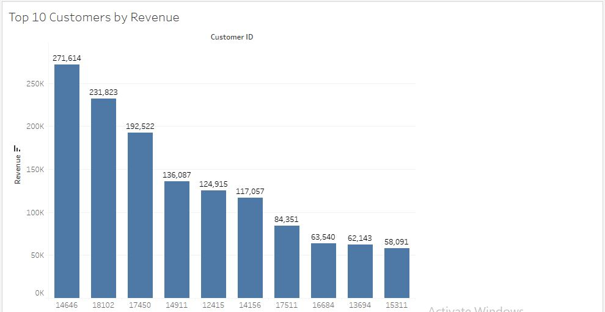
TOP 10 CUSTOMERS
The company can aim to strengthen the relationship with these customers and increase the customer loyalty and ultimately more revenue can be generated

Slide 9
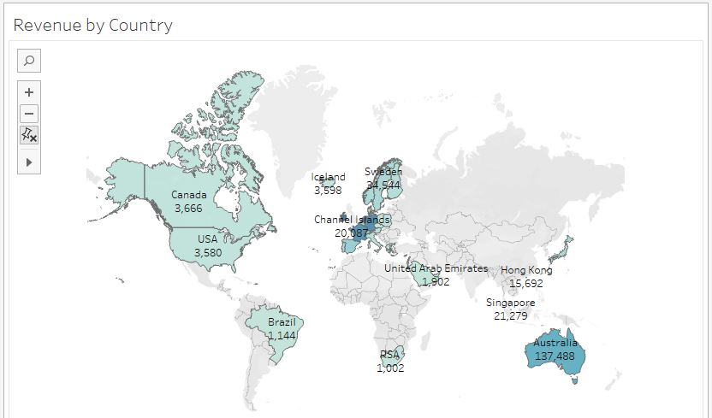
REVENUE BY COUNTRY
The above visual shows that the majority of the sales occur in the European Market

Slide 10
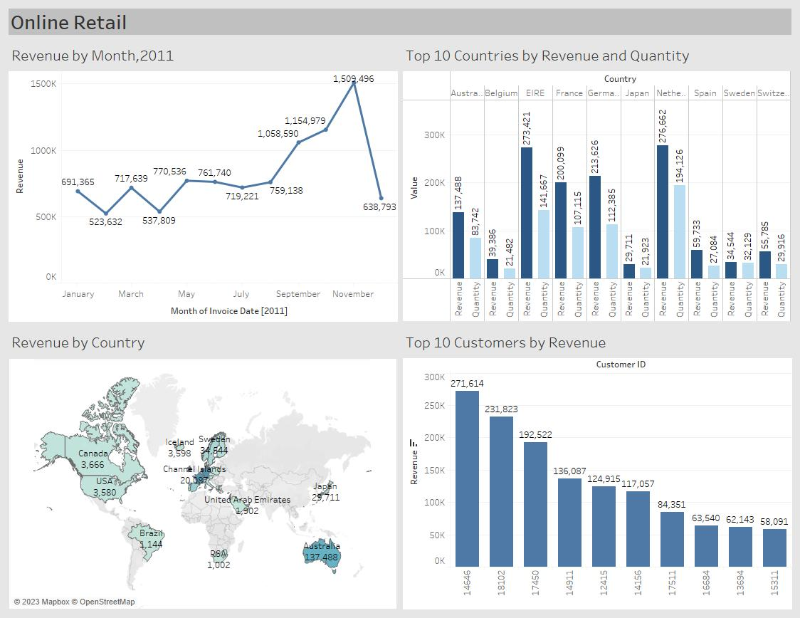
DASHBOARD

Slide 11
INSIGHTS
The company should develop strategies focused on maintaining seasonal product inventory to capitalize on increased demand and boost sales during peak seasons
The company should deeply analyze the products that are in high demand and come up with more marketing strategies
The company should explore offering incentives to its highest revenue generating customers
The European market offers significant growth potential, and the company should focus on implementing strategies aimed at enhancing its market presence and its positioning in the market
For low revenue markets, company should do a proper market research and boost marketing efforts.

Slide 12
THANK YOU

